Slide 1
The parent and guardian’s role in the college admission process
Parent workshop
december 5, 2015
Nicole gallacher - school counselor - John jay high school

Slide 2
Opening Questions
What grade is your student in?
Have you been through this process before?
How much intervention and assistance does your student need? Significant? Moderate? Minimal?

Slide 3
The College Search Process
There are an overwhelming amount of options, how can you narrow down to a more manageable list of potential schools?

Slide 4
Naviance
All students should have registered with Naviance at school with their school counselor
Parents can open account as well through the school counselor

Slide 5
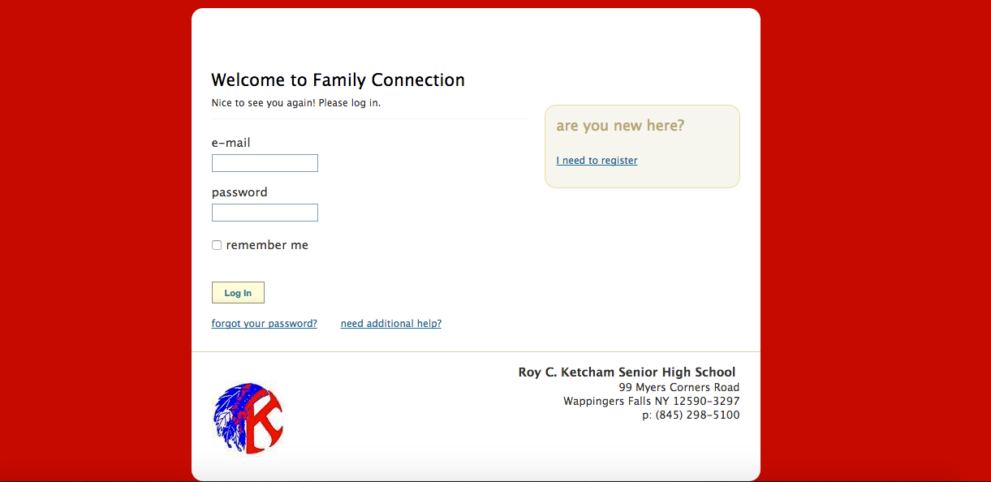
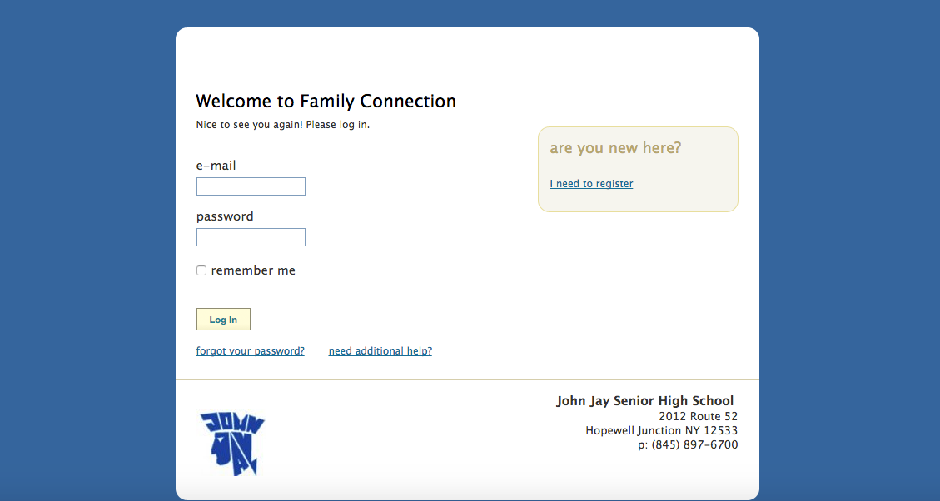
Family Connection
Log in at www.connection.naviance.com/johnjay - www.connection.naviance.com/rck

Slide 6
College Visits
Start Local
College fairs are a great ice breaker and a way to gather a large amount of information in one stop
SUNY College Fair at SUNY New Paltz: September 22, 2016 6pm-8pm
Dutchess County Counseling Association Presents Dutchess Community College College Fair: October 17, 2016 6-8 pm
Danbury College Fair at Danbury Fair Mall: October 17, 2016 5pm-8:30pm
Marist College Fair - Spring 2017
Visit when students are on campus (Wappingers Spring Break)
Try a variety (public/private, large/medium/small, urban/suburban, etc…)
Check in with admissions
Meet important people, see important facilities (coaches, professors, specialty programs, extra curricular, etc…
Get out there!

Slide 7
College Score Card
Website: https://collegescorecard.ed.gov/
Compare colleges using data as you narrow down your options
Perform college search

Slide 8
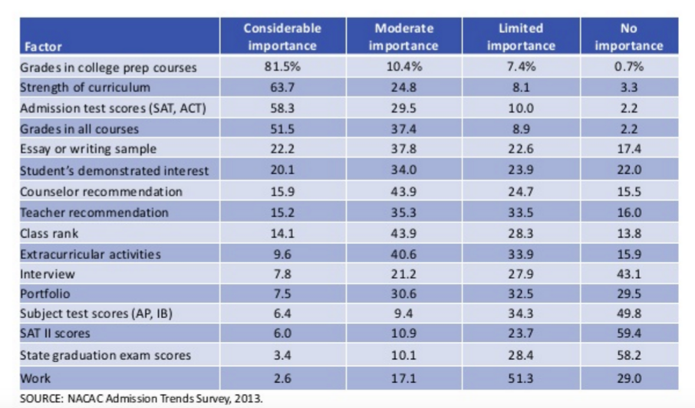
Factors in college admissions decisions
Provided by nacac - visit their website - http://www.nacacnet.org/studentinfo/Pages/Default.aspx

Slide 9
Applying
Much of the application process happens through Naviance
Recommendation letters
Transcript submission
Monitoring your application submission status
Mid-year reports
Common Application
https://www.commonapp.org/
SUNY Application
https://www.suny.edu/applysuny/

Slide 10
Costs and Financial Aid
Net Price Calculator
https://collegecost.ed.gov/netpricecenter.aspx
Free Application for Federal Student AID (FAFSA)
https://fafsa.ed.gov/
FAFSA Forecaster
New York State Tuition Assistance Program - TAP
https://www.hesc.ny.gov/pay-for-college/apply-for-financial-aid/nys-tap.html
Federal Student Aid
https://studentaid.ed.gov/sa/

Slide 11
Costs and Financial Aid
Research outcome of graduates of particular college and major and compare to college costs
Average amount of student debt is 30,000 after 4 years
FAFSA
File for FAFSA, even if you don’t think you will get aid
You MUST create 2 separate accounts for student and parent, with each individual email attached
If all parents have not provided information, financial aid may not be awarded (by government or by institution)

Slide 12
Changes to FAFSA
FAFSA for current Seniors and beyond, Prior-Prior-Year tax information (File in October of Senior Year)
Website rollover to .gov from .com
College list can no longer be viewed by the other schools your student has applied to and schools should NOT ask for access to this list
PIN changes to FSAID
If you have an older student and already have an account, you will match the PIN to the FSAID to save time and energy

Slide 13
Other Resources
College Admissions Office
College Financial Aid Office - For specific questions
Dutchess Community College Financial Aid Office
Offers general financial aid information to ALL families in our county
Your student’s School Counselor
When in doubt, email or call! If we don’t know, we will find someone who does.

Slide 14
THank you

